Slide 1
Mineral & Rock Review
Chapters 3 & 4

Slide 2
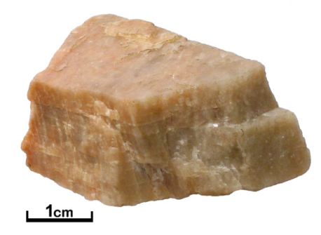
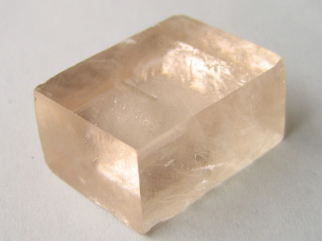
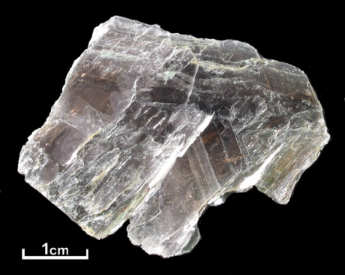
Minerals
A naturally occurring, inorganic solid with crystal structure and a definite chemical composition
Families of minerals are based on what elements they are made of
The two most common elements in the crust are silicon and oxygen, which makes up the silicate family
Properties to identify minerals include luster, streak, cleavage/fracture, hardness, and specific gravity/density
Quartz
Feldspar
Calcite
Muscovite

Slide 3
Some Minerals Found in VA
Calcite
Turquoise
Hematite
Amethyst
Pyrite
Barite
Mica
Halite
Gypsum
Feldspar

Slide 4
Minerals Video
https://www.youtube.com/watch?v=32NG9aeZ7_c

Slide 5
It’s a Hard Rock Life
Rocks form due to many natural processes, such as weathering, erosion, cementation, heat, and pressure….it’s called the ROCK CYCLE!

Slide 6
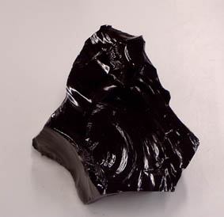
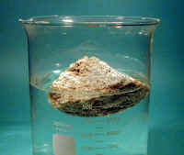
Igneous Rocks
Igneous rocks form from cooling magma/lava
If they cool fast, they have small mineral grains, and if they cool slow, they have large mineral grains
Igneous rocks that cool on the Earth’s surface, they are extrusive
Igneous rocks that cool below the Earth’s surface are intrusive
Texture and composition are the two most important things to remember when you are identifying igneous rocks
Granite
Obsidian
Pumice

Slide 7
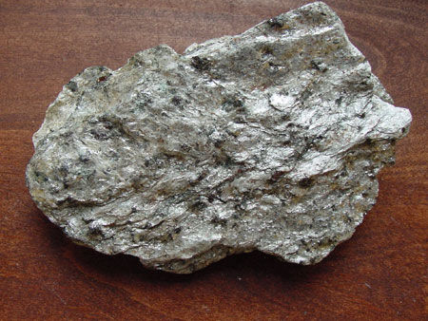
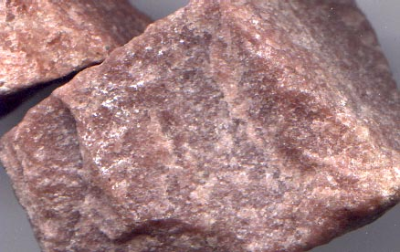
Metamorphic Rocks
Metamorphic rocks have to be some other rock type before they become metamorphic…called the parent rock
Fall into two groups: foliated or nonfoliated
Foliated have alternating layers of minerals and nonfoliated do not
FOLIATED
Gneiss
Schist
NONFOLIATED
Quartzite

Slide 8
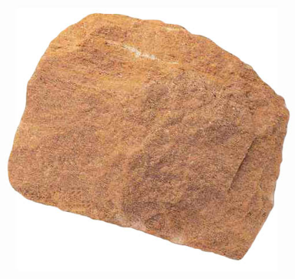
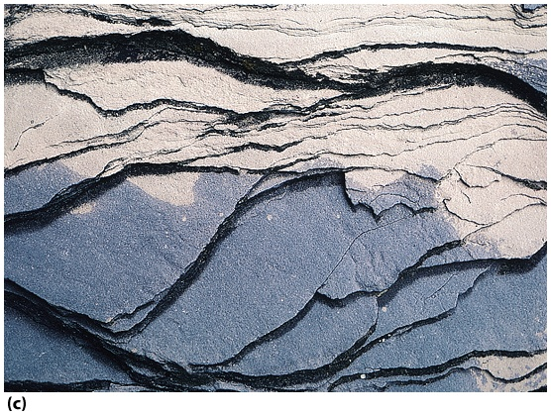
Sedimentary Rocks
Limestone
Sedimentary rocks are made of weathered and eroded bits of other rocks that get cemented and compacted together
Typically find fossils in this rock type
Sandstone
Shale

Slide 9
Rocks Found in VA
Slate (BR, P)
Phyllite (BR, P)
Soapstone (BR, P)
Gneiss (BR, P)
Granite (BR, P)
Rhyolite (BR, P)
Basalt (BR, P)
Conglomerate (CP, VR, AP)
Shale (VR, AP)
Limestone (VR, AP)
Sandstone (CP, VR, AP)
Coal (AP, CP)
Chalk (CP)
Coquina (CP)

